Slide 1
Machine Learning: Final Projects Presentation
Gotham Cabs & Botanist
Team No.: 24
Team Member: Abhijeet Kothari

Slide 2

Gotham City Cabs

Slide 3
Data Operations
Feature Engineering:
Date, Time, Month, Year, Weekday, Part of the day (morning, afternoon, etc.), part of the month (early month, mid month, etc.)
Distance between the pickup point and drop-off points.
Data Cleaning
Drop columns: pickup_datetime, year. time, pickup_x, pickup_y, dropoff_x, dropoff_y, date.
Rearranging the columns.
Removing rides with 0 riders.
Handling outliers and skewed data with log function.
Encoding categorical features.

Slide 4
Models & Efficiency
Following models have been trained:
Linear Regression Model
Ridge Model
Lasso Model
Random Forest Regressor Model
Decision Tree Regressor
Linear Regression Model
Ridge Model
Lasso Model
Random Forest Regressor Model
R2 Score 0.66 | MSE: 0.202 | MAE: 0.300
R2 Score 0.65 | MSE: 0.210 | MAE: 0.316
R2 Score 0.65 | MSE: 0.211 | MAE: 0.357
Parameter Tuning (using GirdSearchCV) has been performed in few models to improve the efficiency of the models.
R2 Score 0.62 | MSE: 0.225 | MAE: 0.459

Slide 5
Plants Image Classifier (Using PyTorch)

Slide 6

Transformation Steps
In order to generalize the network for better performance, following steps are performed:
Random Rotation
Random Scaling
Cropping (224 X 224 pixels)
Color Channel Normalization (Shifted each color channel to be centered at 0 and range from -1 to 1)
The above transformations are performed on the training Dataset. For validation dataset and testing dataset, only resize and crop operations are performed.

Slide 7
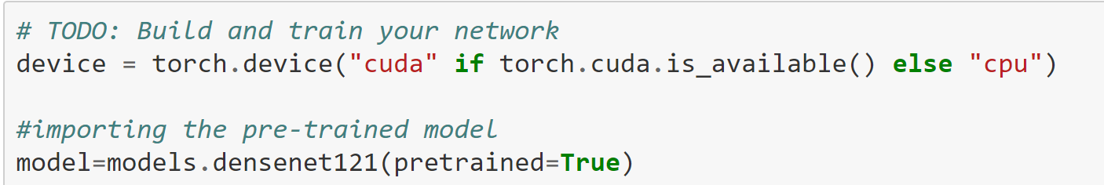
Building and Training the Classifier
Used one of the pretrained models from torchvision.models to get the image features. Built and trained a new feed-forward classifier using those features.
Following steps are performed :
Load a pre-trained network (DenseNet121).

Slide 8
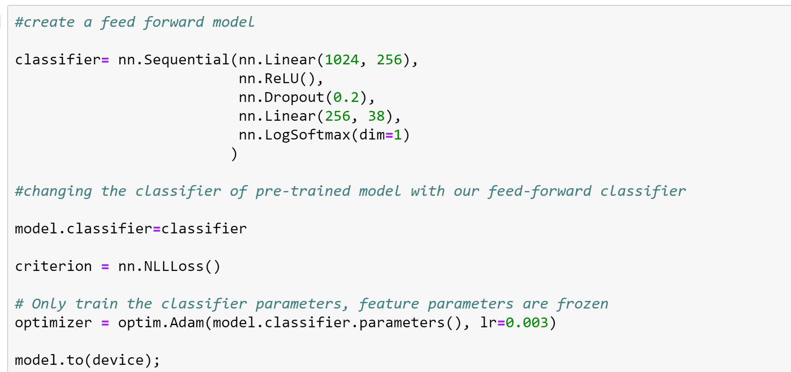
Define a new, untrained feed-forward network as a classifier.
Input layers: 1024
Hidden layers: 256
Output layers: 38
Activation Function: ReLU
Loss Function: Negative Loss Likelihood Function

Slide 9
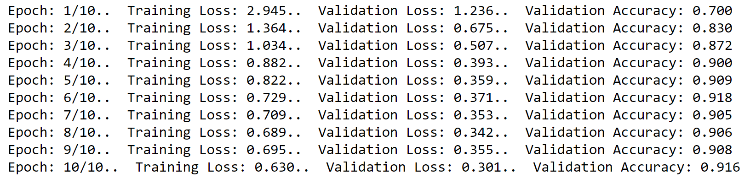
Train the classifier layers using backpropagation using the pre-trained network to get the features.
For each epoch (total epochs =10) following steps were performed:
Iterate through data loader
Calculated the classifier parameters through the ‘model.forward()’ function.
Calculated loss
Modified the parameters of classifier using back propagation.
Calculated training loss, validation loss and validation accuracy for each epoch.
Track the loss and accuracy on the validation set to determine the best hyperparameters.

Slide 10

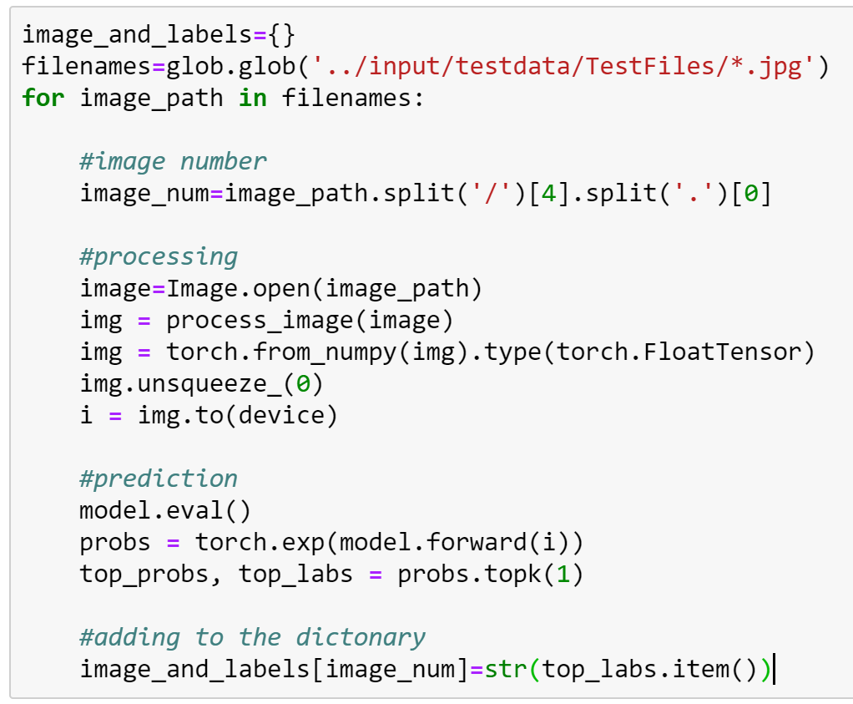
Predictions
Iterated through images on test dataset one by one and processed each image.
Created a function called predict that takes an image and a model, then returns the top class along with the probability.
Save the image name and it’s predicted class in a dictionary.
Created the data frame from the dictionary and reindexed it accord to the test response file.

Slide 11
Thank you!

